Slide 1
Javascript useful console methods()
{
Part (1)
}
...

Slide 2
Table of contents
01
02
03
Log method()
Debug method()
03
Info method()
04
Warn method()

Slide 3
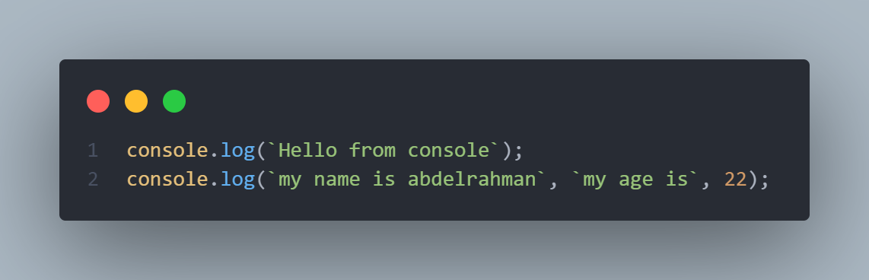
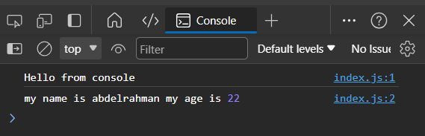
Log method()
{
Certainly! In JavaScript, console methods are used for logging information to the browser's console, you can pass one or more argument to log() to display multiple values in one log method
Output :
}
...

Slide 4
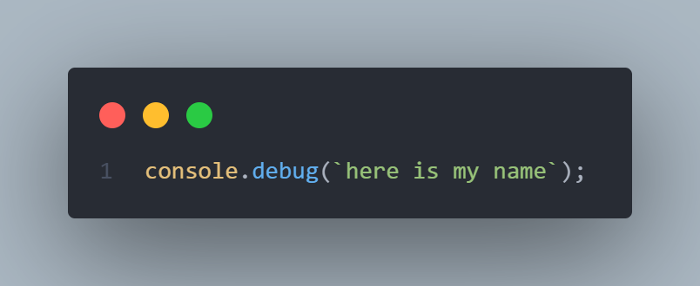
Debug method()
{
console.debug() method is not universally supported in all browsers.
In terms of usage, console.debug() is intended for logging debug messages, much like console.log() . However, developers often use console.log() for general logging
}
...

Slide 5
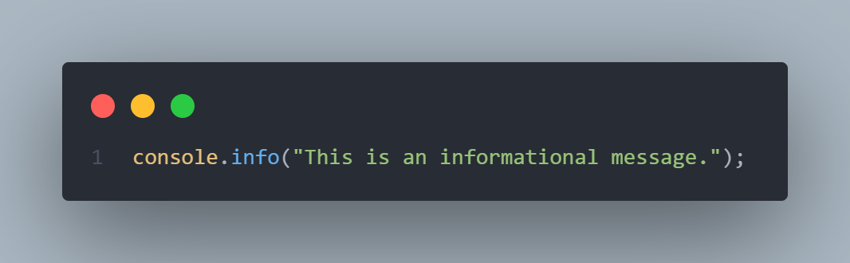
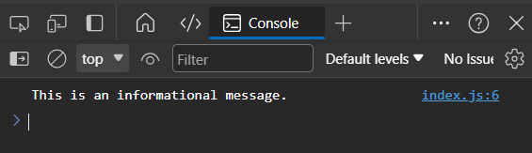
Info method()
{
The console.info() method in JavaScript is used to log informational messages to the console. This method is similar to console.log() but it is specifically intended for providing information rather than generic logging. The appearance of the logged message in the console may vary between browsers, but it often stands out as an informational message.
}
...

Slide 6
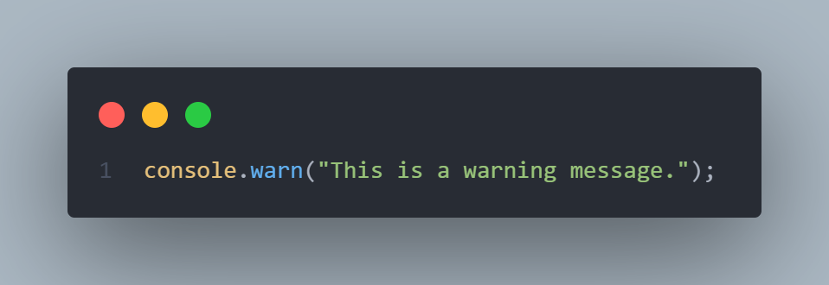
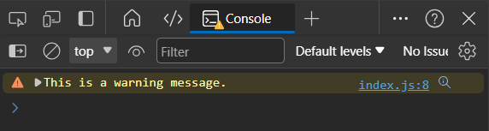
Warn method()
{
The console.warn() method in JavaScript is used to log warning messages to the console. It is specifically designed for situations where there is a potential issue or a warning that developers should be aware of. When you use console.warn() the logged message often appears with a distinctive warning icon in the browser's console.
}
...

Slide 7

{
*
..
Abdelrahman hassan
Front-end (React) Developer
}
..

Slide 8





Thanks!
< Do you have any questions? >

